Slide 1
UNIT-II
LOGIC FAMILIES

Slide 2
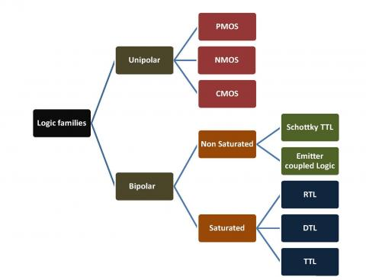
TYPES OF LOGIC FAMILY

Slide 3
Emitter-Coupled Logic (ECL)
Non saturated digital logic family & Used in high speed circuits
Propagation rate as low as 1-2ns
Noise immunity and power dissipation is high compare of all logic families.
It is also called as current mode logic. The design of ECL circuit consists of transistors and resistors.
By preventing the transistor from entering into saturation, the high-speed operation is achieved in ECL logic family.
Very small voltage swing is necessary to switch between the two different voltage levels. This cannot be achieved in transistor-transistor logic, as the transistors enter into saturation mode, while in operation.
Emitter-coupled logic family offers an incredible propagation delay of 1ns.
The delay is more reduced in the latest ECL families.
Notes:
‹#›

Slide 4
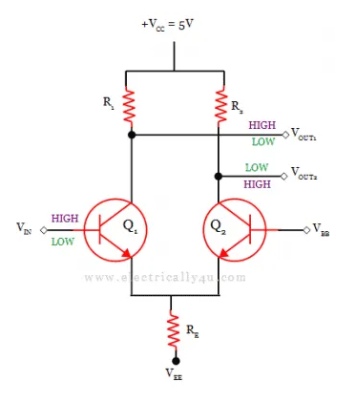
Inverter Circuit of Emitter Coupled Logic (ECL)

Slide 5
ECL NOR / OR
The circuit has 2 outputs- inverting and non inverting output, input low is 3.6 V, input high is 4.4V.
When A=B=0, so Q1, Q2 are OFF, then Out1=High and Out2=Low.
When A=B=1, so Q1, Q2 are ON, then Out1= low and Out2=High.

Slide 6
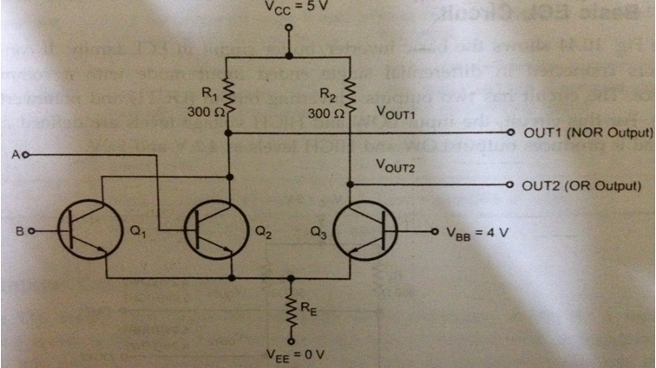
ECL (NOR/OR GATE)

Slide 7
Integrated Injection Logic
Integrated injection logic (IIL, I2L, or I2L) is a class of digital circuits built with multiple collector bipolar junction transistors (BJT).
When introduced it had speed comparable to TTL yet was almost as low power as CMOS, making it ideal for use in VLSI (and larger) integrated circuits.
The gates can be made smaller with this logic family than with CMOS because complementary transistors are not needed.
Although the logic voltage levels are very close (High: 0.7V, Low: 0.2V), I2L has high noise immunity because it operates by current instead of voltage.
I2L was developed in 1971 by Siegfried K. Wiedmann and Horst H. Berger who originally called it merged-transistor logic (MTL).
A disadvantage of this logic family is that the gates draw power when not switching

Slide 8
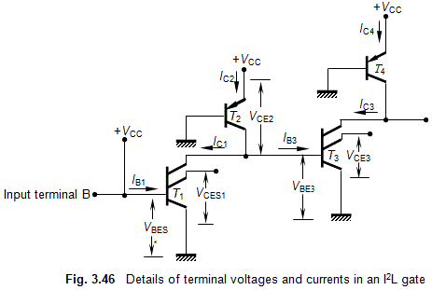
Operating Principles of I²L gates
Integrated Injection Logic Operation is explained as follows. To understand the working of a typical I²L gate, consider the figure, which consists of five transistors, connected as shown.
It can be seen that the base current I_{B1} of T₁ is derived from +V_{CC} through the input terminal B. The base-bias current I_{B3} of transistor T₃ and the collector current I_{C1} of T₁ are obtained from the collector current of transistor T₂ whose injector (emitter) also is connected to +V_{CC}.

Slide 9
If I_{B1} is sufficient, the base-to-emitter voltage V_{BE1} of T₁ will become the saturation base-emitter voltage V_{BES1} (= 0.8 volt), and in this condition, its collector-to-emitter voltage V_{CE1} will become saturation base-emitter voltage V_{CES1} (= 0.2 volt).
So, we find that T₁ is in the ON-state and its output is at logic-0 level. Since V_{CES1} = 0.2 volt, the collector current I_{C2} of T₂ will flow through the collector of T₁ as I_{C1}, and V_{BE3} of T₃ = 0.2 V = V_{CES1}.
This means that at this moment, T₃ is OFF and its collector-emitter voltage V_{CE3} = 0.8 volt. Now, let the input voltage V_{i} = 0 V. This makes transistor T₁ to be in OFF-state, and I_{C2} to flow through the base of T₂.
Thus, V_{BE3} = V_{BES3} = 0.8 V. This makes V_{CE1} = V_{BES3} = logic 1, and V_{CE3} = V_{CES3} = logic 0.
Thus, the transistors perform inversion operation, with logic 0 = V_{CES} = 0.2 V, and logic 1 = V_{BES} = 0.8 V. The voltage swing of this gate, therefore, is V_{swing}=V_{BES} – V_{CES} = 0.8 – 0.2 = 0.6 volt
It can be seen that the logic swing of I²L gates is very low and this is a major defect of these gates.

Slide 10
Advantages of I²L Gates
Since I²L gates are made up only of BJTs, they possess high speed of operation. Because only transistors are used for the construction, I²L gates have high packing density, and are hence suitable for construction of VLSI circuits.
· Very low power-supply requirement (1 volt) .
· Low power dissipation
.
· Number of processing steps required is small; hence cost per gate is low.
· Several functions are possible on the same chip.
· Using bipolar technology, it is possible to combine I²L gates with other logic families.

Slide 11
Disadvantages of I²L Gates
Very low voltage swing (≈ 0.6 V); the swing is between V_{BES} (0.8 V) and V_{CES} (0.2 V).
· Lower packing density than NMOS.
· Lower noise margin.
· External resistance required for proper functioning.
· I²L technology, at present, is dormant.

